Slide 1
Development of Genomic Resources for Management of Verticillium wilt of Potato

Slide 2
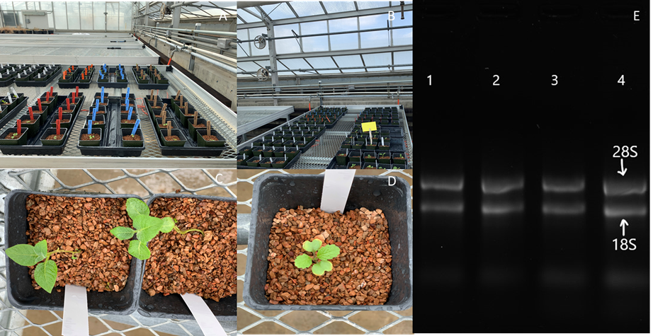
Material and methods
Host
Solanum tuberosum
Brassica juncea
Pathogen
Vd-653
Vd-111
Control
Sample collection
RNA extraction and cDNA synthesis
Gene selection and primer design
qRT-PCR
Fold change calculation: delta delta Ct method

Slide 3
Gene Expression Validation Using qRT-PCR
DESeq2 uses linear regression to estimate fold change after normalization of data
Show foldchange data separately for qPCR and RNA-Seq??
Other plot type to present RNA seq data???

Slide 4
Correlation Analysis between RNA-Seq and qRT-PCR fold change data
Why correlation??
Different normalization method used by these two methods
Other data analysis option??

Slide 5
Host | Evaluated |  | Validated
 | DEGs | Comparisons | DEGs | Comparisons
Solanum tuberosum | 11 | 14 | 9 | 12
Brassica juncea | 9 | 14 | 5 | 10
Verticillium dahliae | 4 | 4 | 4 | 4
Why opposite results?
If housekeeping genes differentially regulated: Checked raw count data neither actin nor elfa genes were differentially expressed
Use of different template
Different sensitivity of two methods
No amplification of genes in certain treatments: Checked raw count data of RNA-seq, no expression thoughout all biological replicates

Slide 6
Solanum and Brassica genes with opposite results
Out of 27 genes, 6 not validated (Wang et al. 2016)
14 out of 18 validated (Guo et al 2017)

Slide 7
Brassica gene (UAB31_ARATH) with no amplification
qPCR Result
RNA seq results (raw count)

Slide 8
Brassica gene (Cluster-15354.125147) with no amplification
qPCR result
RNA-Seq count data

Slide 9
r = 0.97
r = 0.91
r = 0.86
r = 0.85

Slide 10
r = 0.88

